Slide 1
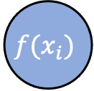
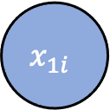

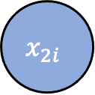


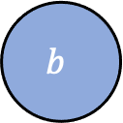

$$x_{1i}$$
$$w_{1}$$
$$x_{2i}$$
$$w_{2}$$
$$sgn⁡(.)$$
$$f(x_{i})$$
$$1$$
$$b$$

